Slide 1

NFL Sports Betting
ACMS 40790 - Programming for Data Science
Frank McGurkin

Slide 2
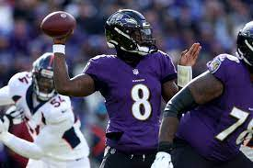
Why NFL Sports betting?
Big sports fan in general - especially the NFL
An estimated $100 billion is wagered during the NFL season at licensed sportsbooks
Best variables to predict outcome of games, bets by looking at the data?
Provide a good model to predict outcomes, help (myself and) others when evaluating their own bets

Slide 3
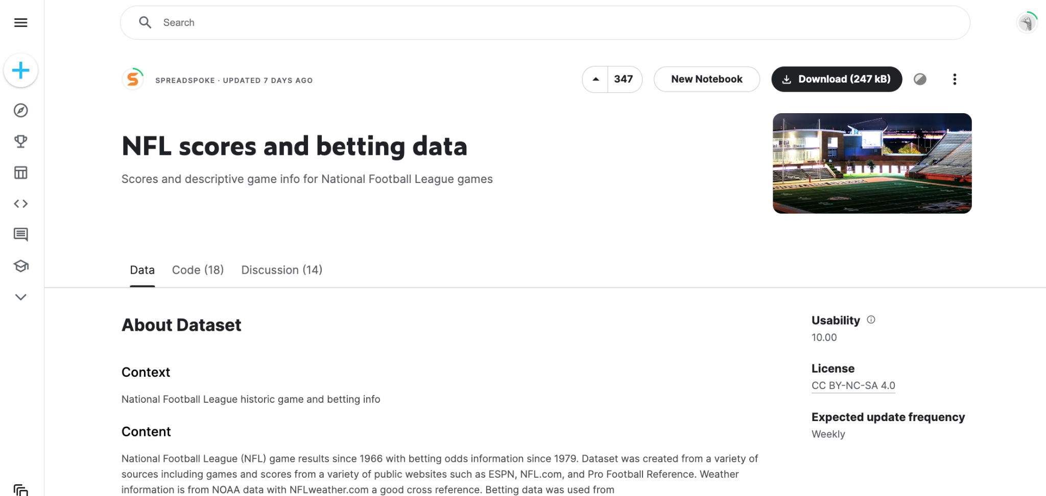
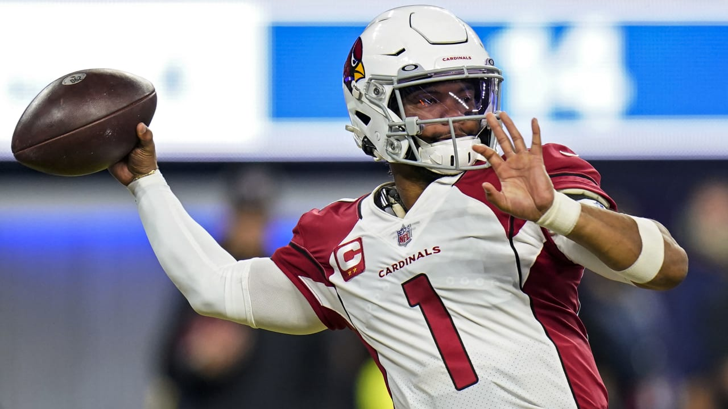
The Data: NFL scores and betting data
Pulled from kaggle
Three data sets:
nfl_stadiums.csv
nfl_teams.csv
spreadspoke_scores.csv

Slide 4
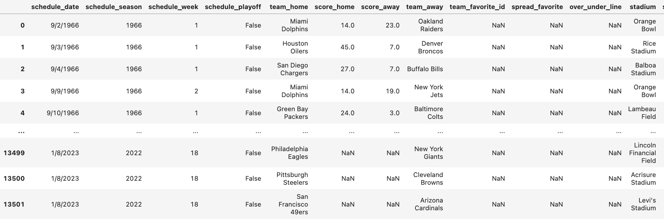
spreadspoke_scores.csv
Data from 1966-2022
17 columns: most relevant:
score_home
score_away
team_favorite_id
spread_favorite
Lacks team statistics: PPG, passing yards, etc.

Slide 5
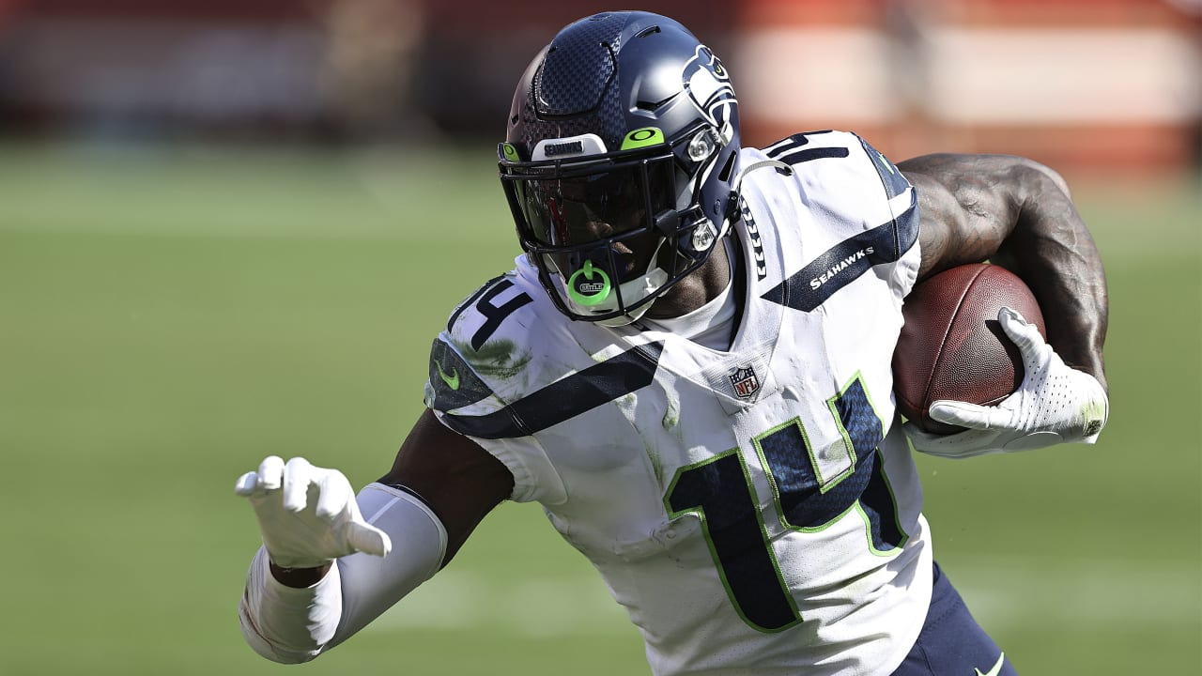
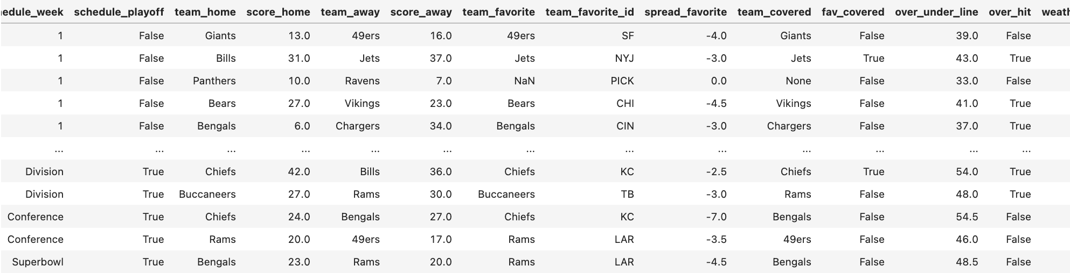
Data Cleaning
Removed observations before 2002, after 2021
2002 - most recent expansion
Dropped irrelevant columns: stadium data
Consistent names across home, away, and favorite team
Added columns: over_hit, fav_covered, team_covered

Slide 6
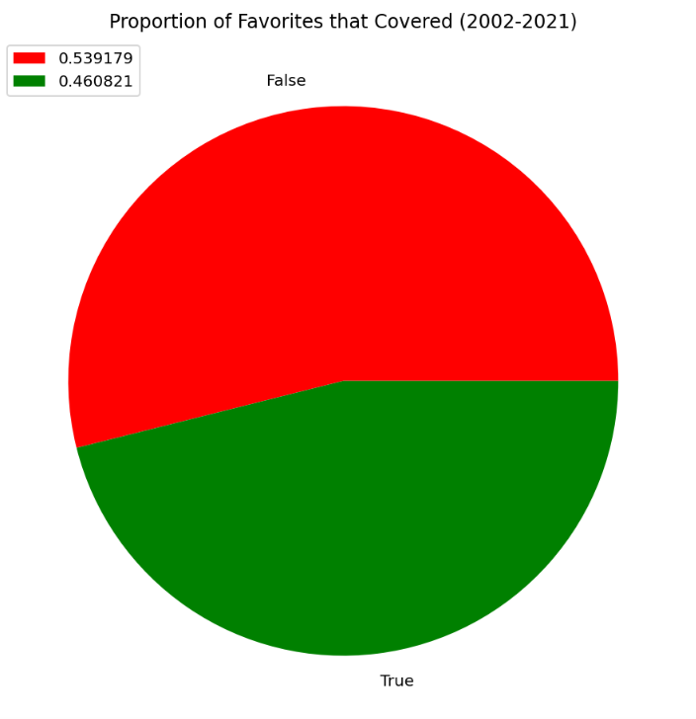
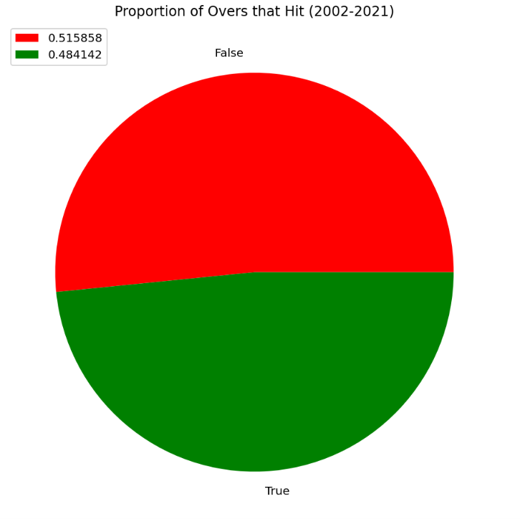
Basic Exploration

Slide 7
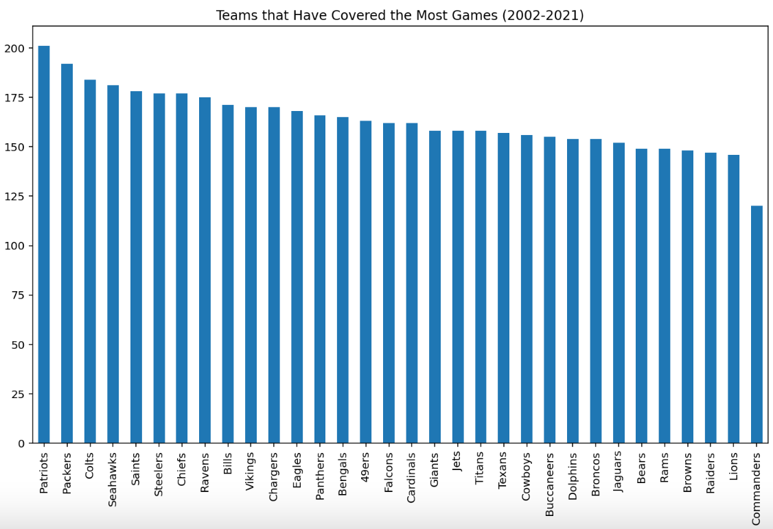
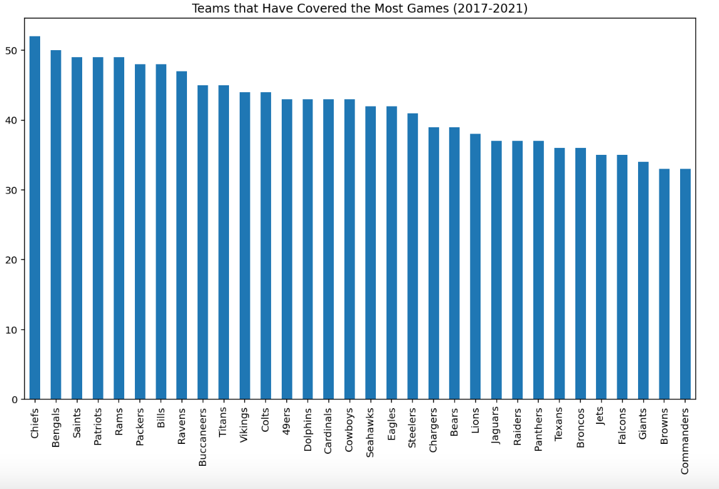
Basic Exploration

Slide 8
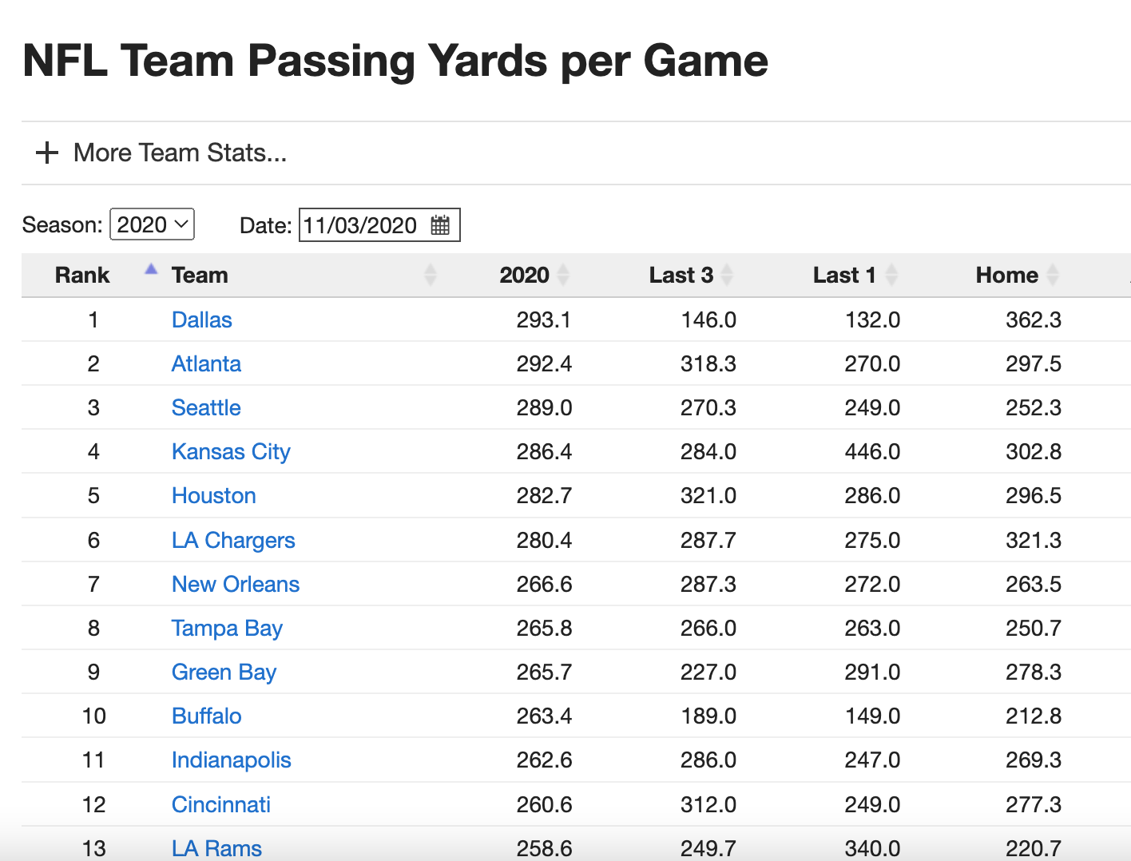
New Data - Team Statistics
Interesting to see spread, favorite data, though not practical for more in depth analysis and prediction
Search for per week team statistics:
Pro Football Focus
teamrankings.com
Could manually pull data from certain season prior to specific date
Would pull three seasons: 2019-2021

Slide 9
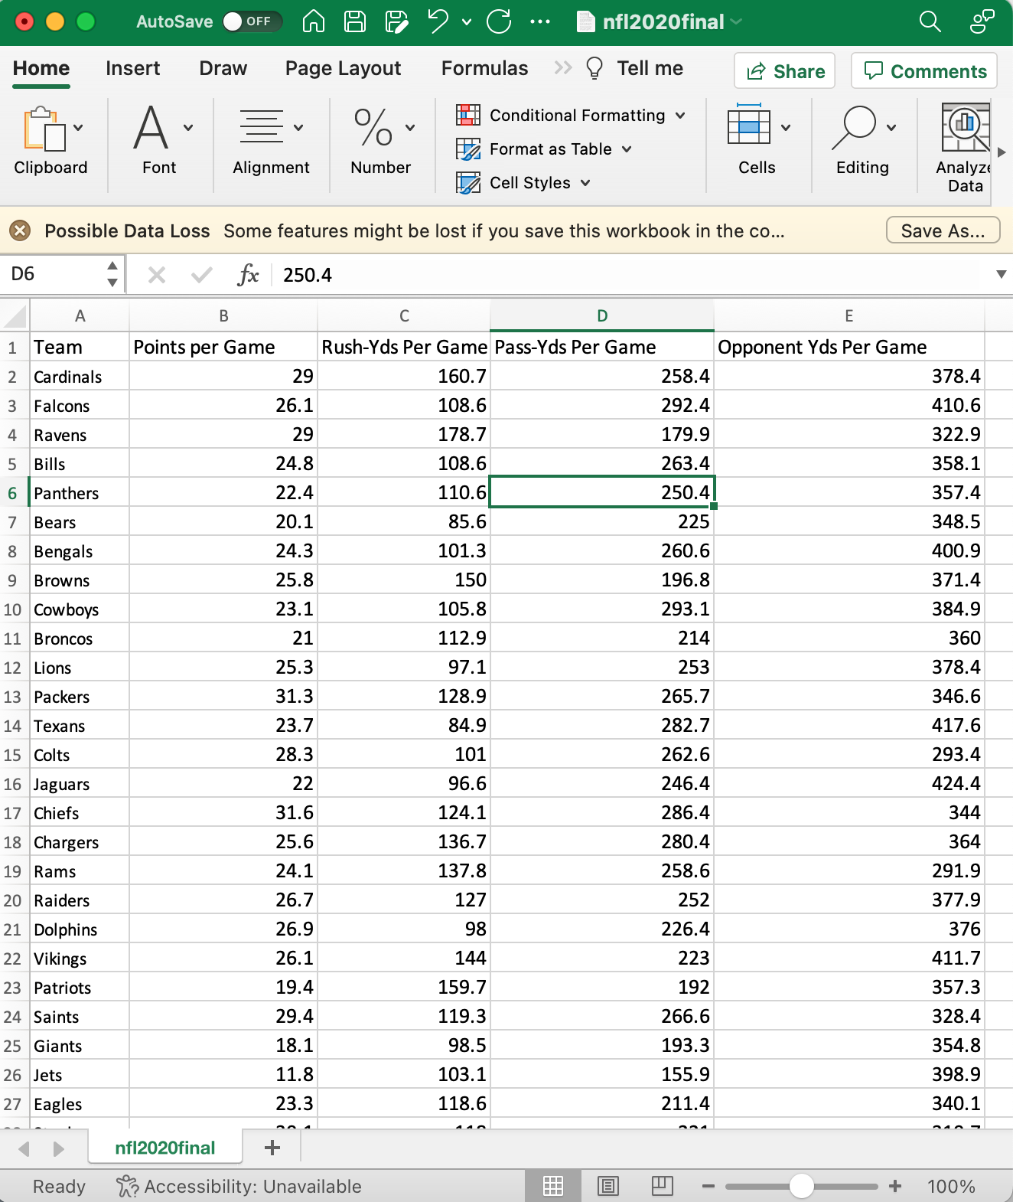
Idea for Prediction
Take weekly averages for favorite, underdog and see how well they predict whether or not the favorite covers
Impractical to do rolling weekly average → take averages from weeks 1 - 8 and predict the rest of the seasons
Predictors: Points per Game, Passing Yds per Game, Rushing Yds per Game, Points Allowed per Game

Slide 10
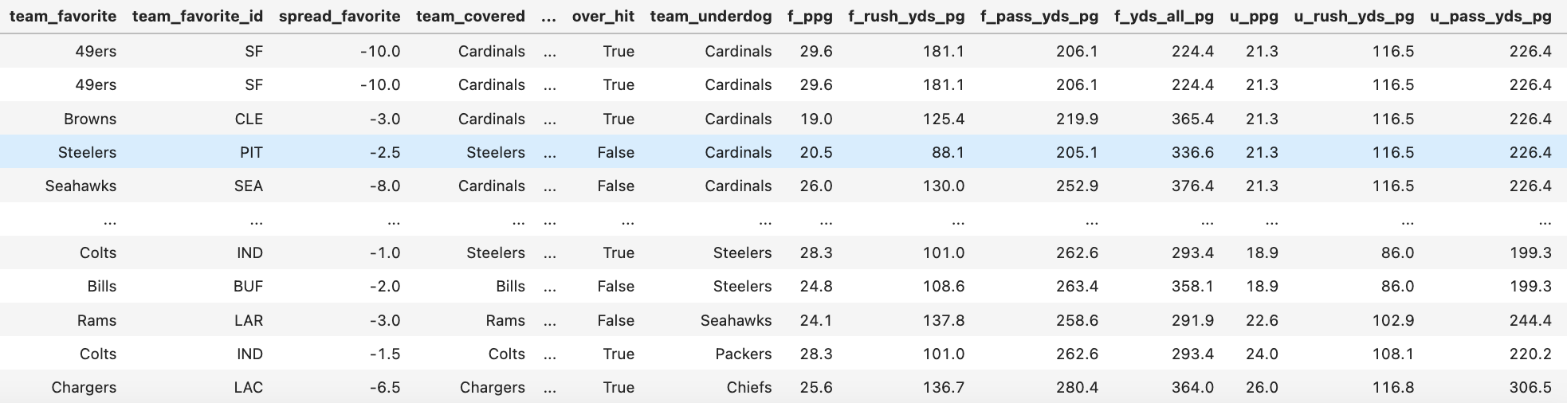
Data Cleaning - Pt. 2
Three new data frames: stats2019, stats2020, stats2021
Removed null values, pulled individual games data from regular season post week 8, 2019-2021
Split into three data frames by year, merged with statistic dataframe twice for favorite, underdog, and then merged the three back together:

Slide 11
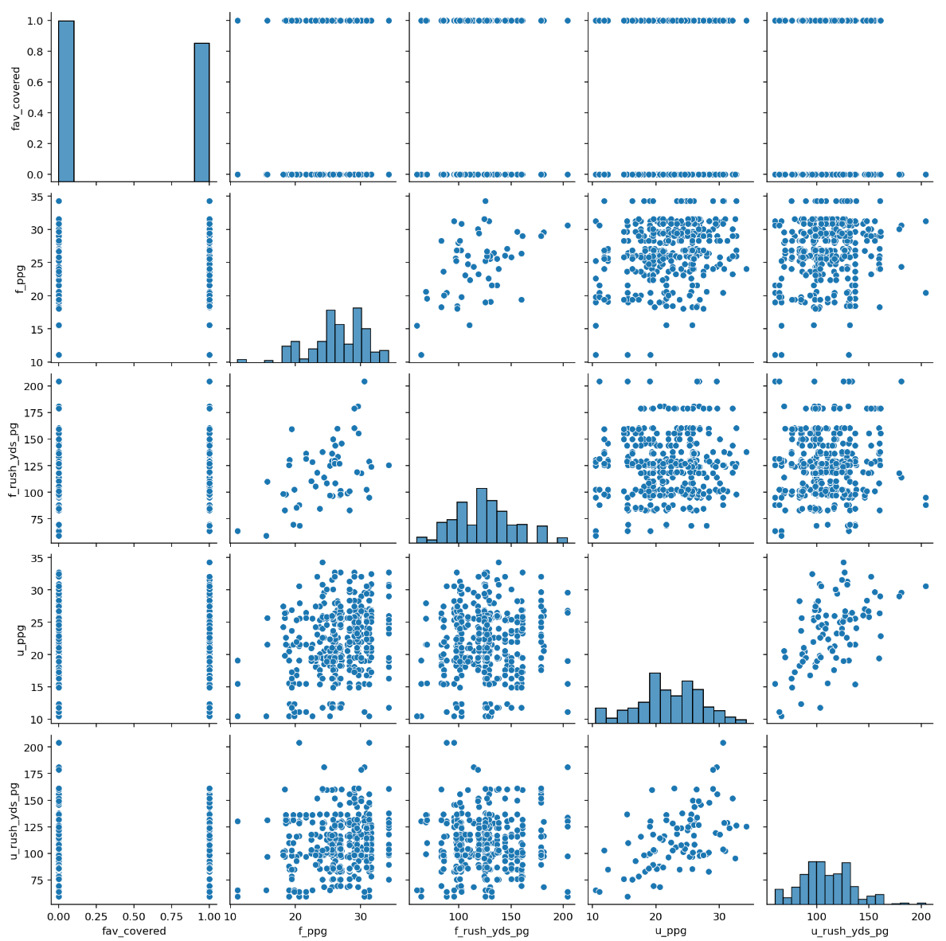
Pairplot

Slide 12
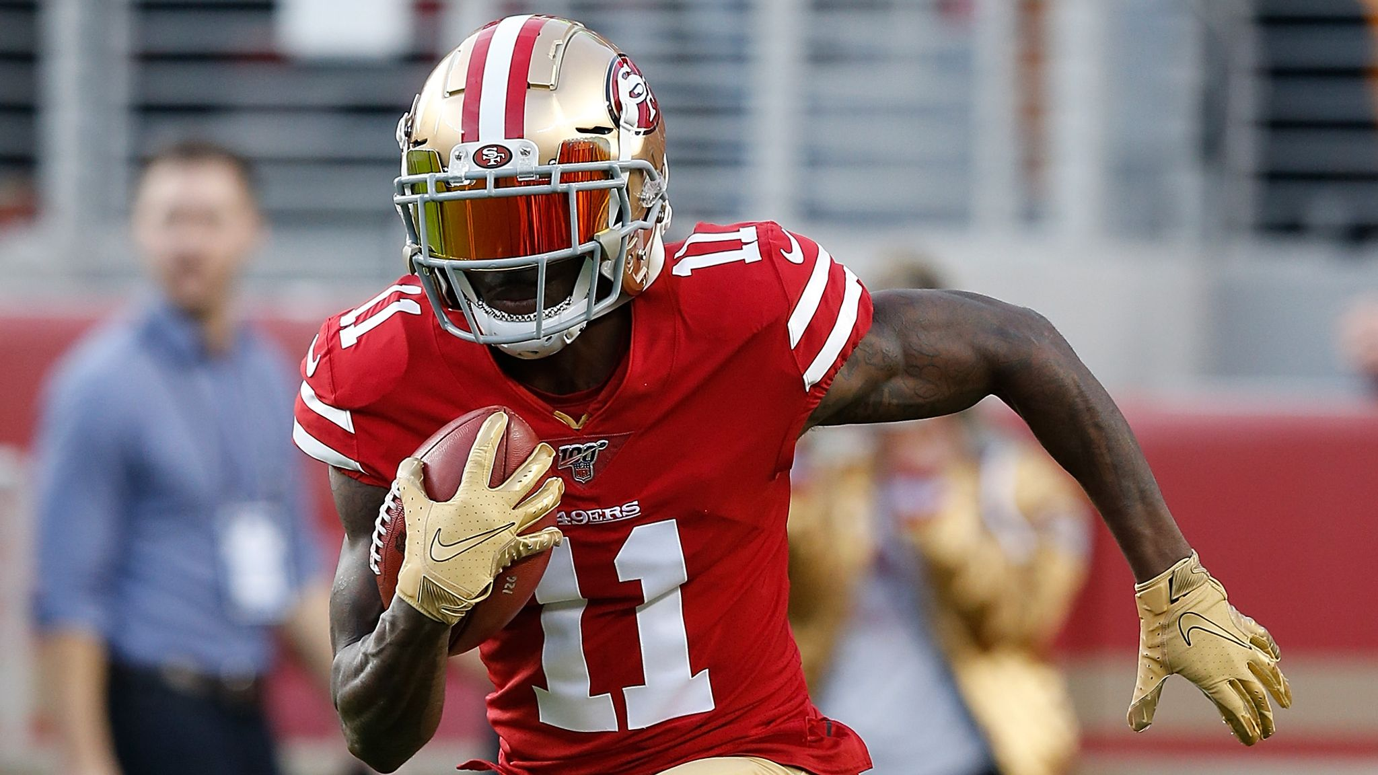
Decision Tree Classifier Model
Default parameters for Random state, Max_depth
Predictors :
'f_ppg', 'f_rush_yds_pg', 'f_pass_yds_pg', 'f_yds_all_pg', 'u_ppg', 'u_rush_yds_pg', 'u_pass_yds_pg', 'u_yds_all_pg'
Dependent variable:
‘fav_covered’
Train on 2019 and 2020 data
Test on 2021 data
Mean absolute error: 0.4338

Slide 13
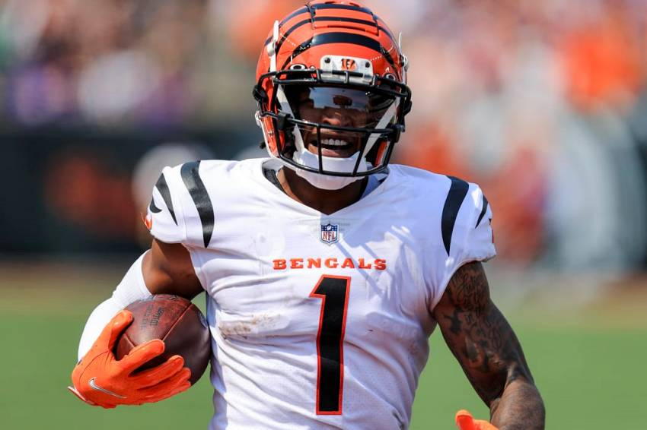
Takeaways and Next Steps
NFL is a difficult sport to predict, would not use this model betting
While team stats are certainly useful in judging the outcome of games, there are a number of other variables that go into it.
Rolling per-game stats
Next steps: more data, different predictors, find ways to account for injuries, other variables
Weather’s impact on point totals
Individual player props

Slide 14
Thank you!

